Slide 1

WELCOME
COHORT 5
7th Sept – 3rd Dec 2026
Suite 6-6-7, Level 6, Menara MAA

Slide 2
React Event System Overview
SyntheticEvents: React's cross-browser wrapper around native events
Consistent behavior across different browsers
Same interface as native events
Automatic event pooling (React 16 and below)
Access to native event via nativeEvent property

Slide 3
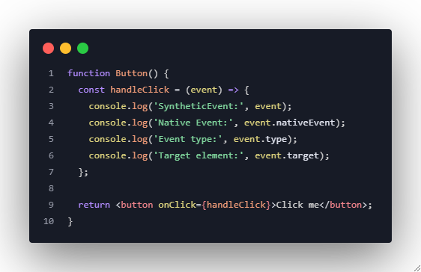
React Event System Overview

Slide 4
Common Event Types
Mouse Events:
onClick, onDoubleClick
onMouseDown, onMouseUp
onMouseEnter, onMouseLeave
onMouseOver, onMouseOut
Keyboard Events:
onKeyDown, onKeyUp, onKeyPress
Form Events:
  onChange, onSubmit
  onFocus, onBlur
  onInput, onSelect
Touch Events:
onTouchStart
onTouchMove
onTouchEnd

Slide 5
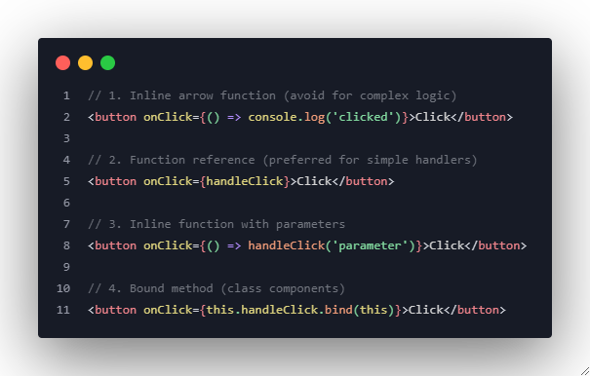
Event Handler Patterns

Slide 6
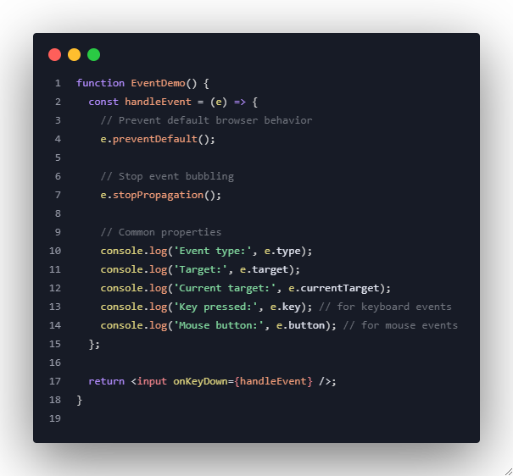
Event Object Properties

Slide 7
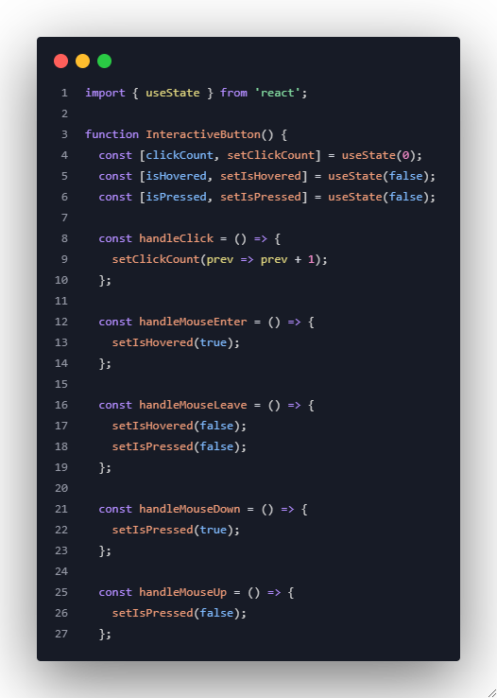
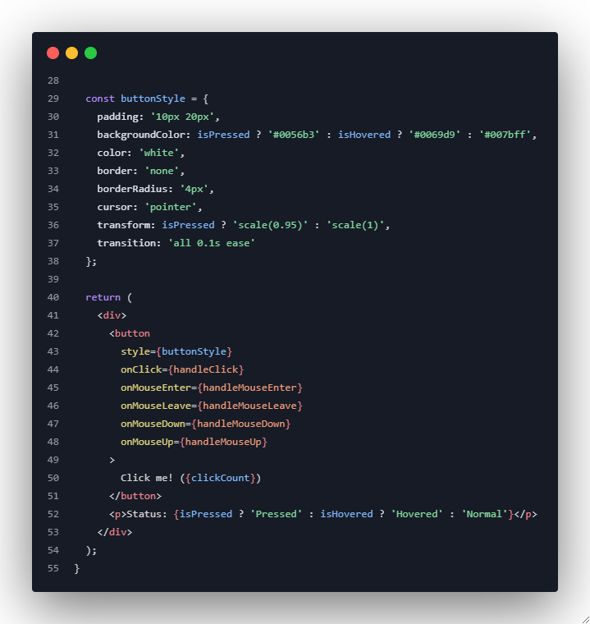
Example 1: Interactive Button Component

Slide 8
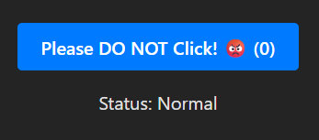
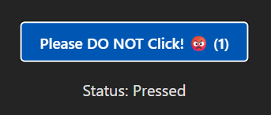
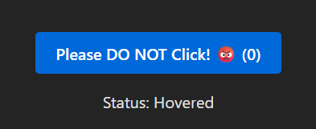
Example 1: Interactive Button Component
Default event
No hover, no click
onMouseDown (true)
onMouseUp (false)
onClick (clickCount)
onMouseEnter (true)
onMouseLeave (false)

Slide 9
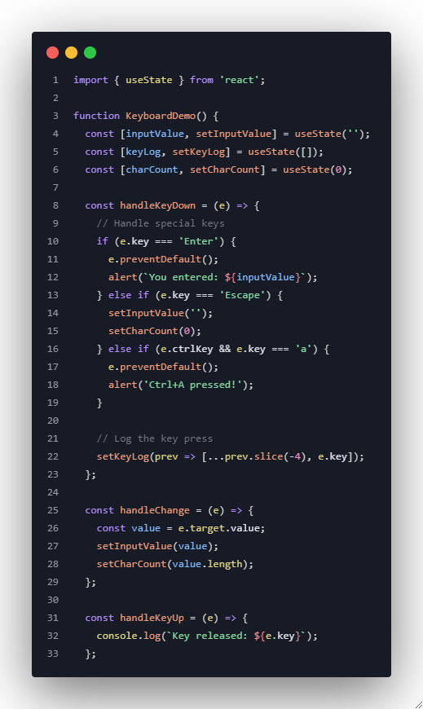
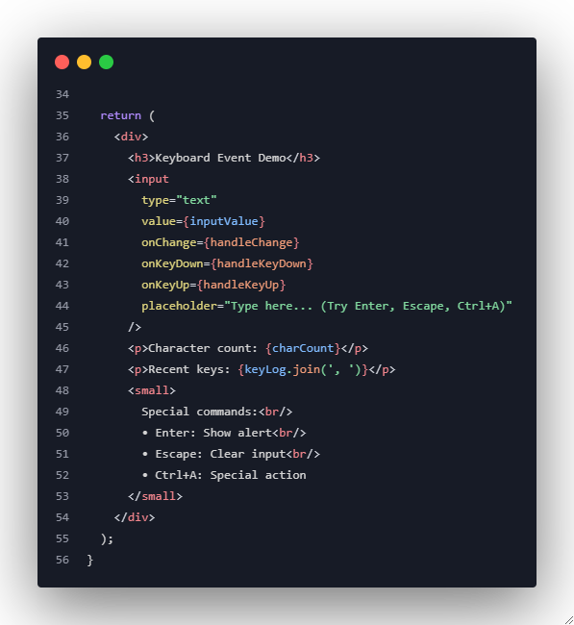
Example 2: Keyboard Event Handling

Slide 10
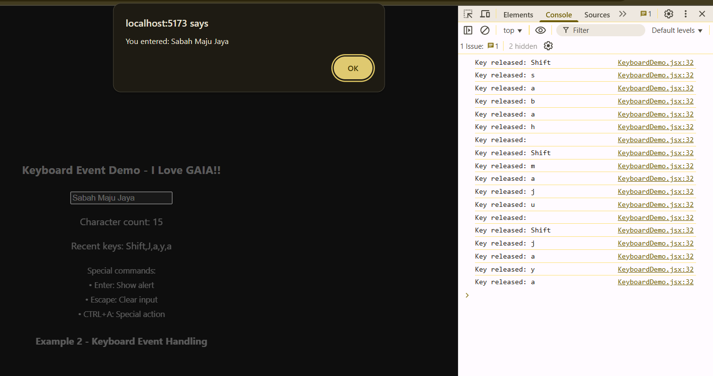
Example 2: Keyboard Event Handling
Keyboard event appeared in console
Special command ‘enter’ from keyboard show alert and input.
Try the other special commands and check the event handling.
Character count = every keyboard event recorded.
Recent keys = max 5 (as per example).

Slide 11
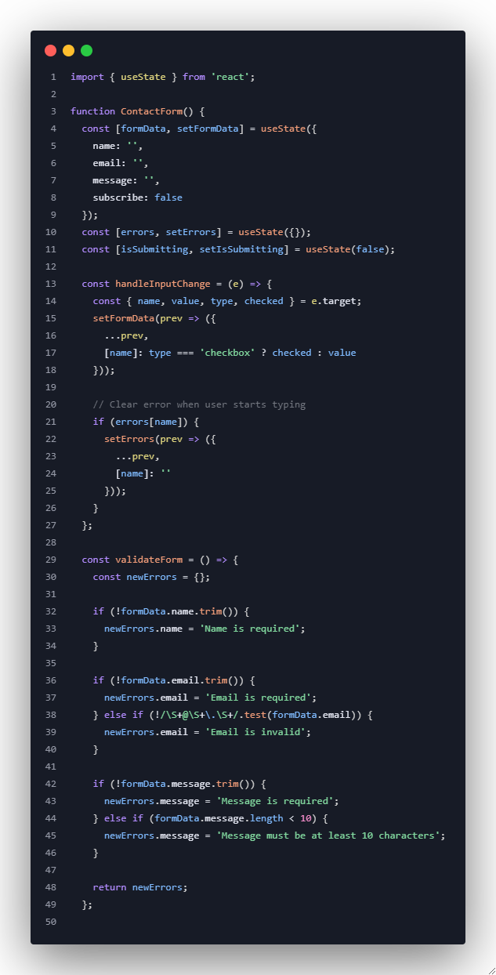
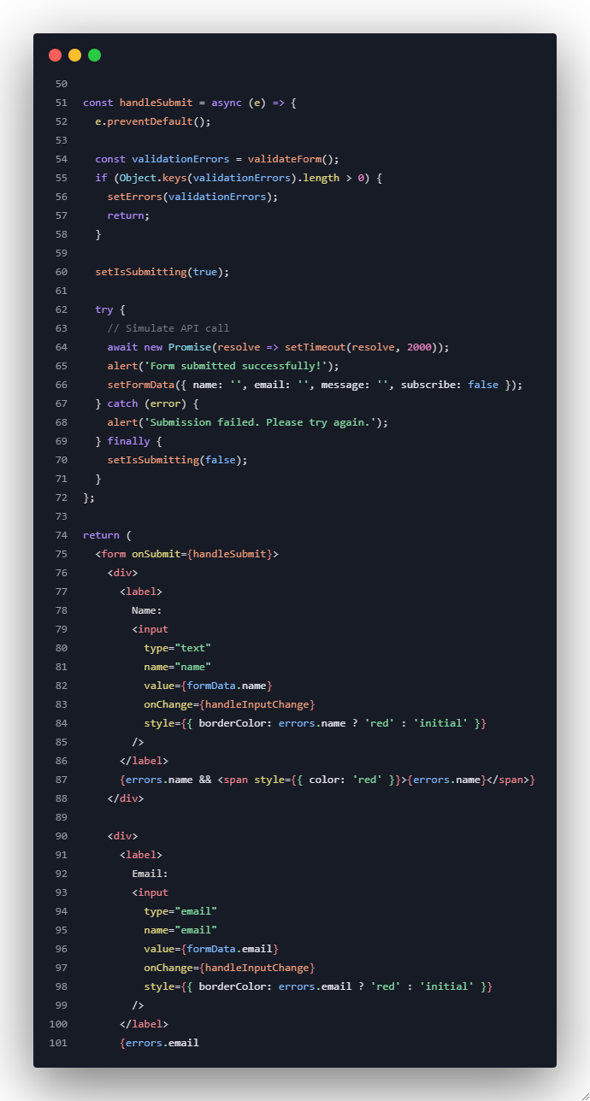
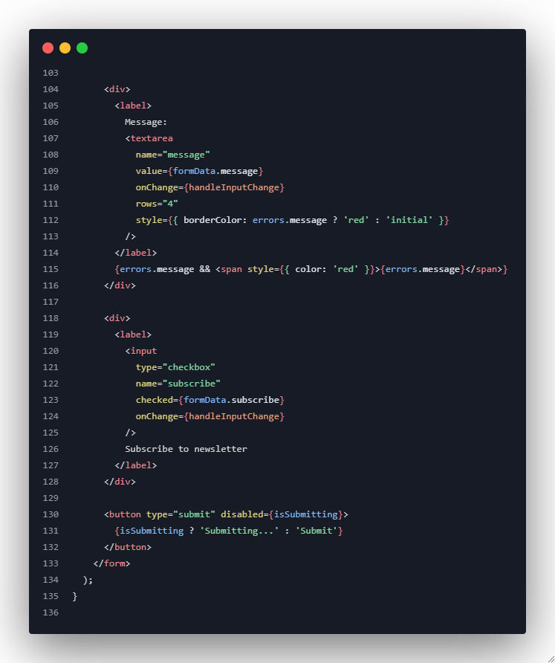
Example 3: Form Handling with Validation
Notes:
import { useState } from 'react';
function ContactForm() {
const [formData, setFormData] = useState({
name: '',
email: '',
message: '',
subscribe: false
});
const [errors, setErrors] = useState({});
const [isSubmitting, setIsSubmitting] = useState(false);
const handleInputChange = (e) => {
const { name, value, type, checked } = e.target;
setFormData(prev => ({
...prev,
[name]: type === 'checkbox' ? checked : value
}));
// Clear error when user starts typing
if (errors[name]) {
setErrors(prev => ({
...prev,
[name]: ''
}));
}
};
const validateForm = () => {
const newErrors = {};
if (!formData.name.trim()) {
newErrors.name = 'Name is required';
}
if (!formData.email.trim()) {
newErrors.email = 'Email is required';
} else if (!/\S+@\S+\.\S+/.test(formData.email)) {
newErrors.email = 'Email is invalid';
}
if (!formData.message.trim()) {
newErrors.message = 'Message is required';
} else if (formData.message.length < 10) {
newErrors.message = 'Message must be at least 10 characters';
}
return newErrors;
};
const handleSubmit = async (e) => {
e.preventDefault();
const validationErrors = validateForm();
if (Object.keys(validationErrors).length > 0) {
setErrors(validationErrors);
return;
}
setIsSubmitting(true);
try {
// Simulate API call
await new Promise(resolve => setTimeout(resolve, 2000));
alert('Form submitted successfully!');
setFormData({ name: '', email: '', message: '', subscribe: false });
} catch (error) {
alert('Submission failed. Please try again.');
} finally {
setIsSubmitting(false);
}
};
return (
<form onSubmit={handleSubmit}>
<div>
<label>
Name:
<input
type="text"
name="name"
value={formData.name}
onChange={handleInputChange}
style={{ borderColor: errors.name ? 'red' : 'initial' }}
/>
</label>
{errors.name && <span style={{ color: 'red' }}>{errors.name}</span>}
</div>
<div>
<label>
Email:
<input
type="email"
name="email"
value={formData.email}
onChange={handleInputChange}
style={{ borderColor: errors.email ? 'red' : 'initial' }}
/>
</label>
{errors.email && <span style={{ color: 'red' }}>{errors.email}</span>}
</div>
<div>
<label>
Message:
<textarea
name="message"
value={formData.message}
onChange={handleInputChange}
rows="4"
style={{ borderColor: errors.message ? 'red' : 'initial' }}
/>
</label>
{errors.message && <span style={{ color: 'red' }}>{errors.message}</span>}
</div>
<div>
<label>
<input
type="checkbox"
name="subscribe"
checked={formData.subscribe}
onChange={handleInputChange}
/>
Subscribe to newsletter
</label>
</div>
<button type="submit" disabled={isSubmitting}>
{isSubmitting ? 'Submitting...' : 'Submit'}
</button>
</form>
);
}

Slide 12
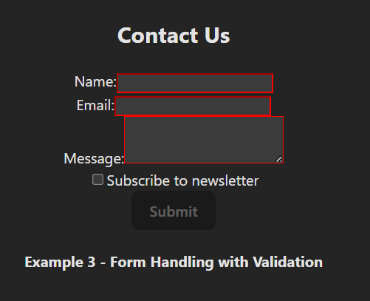
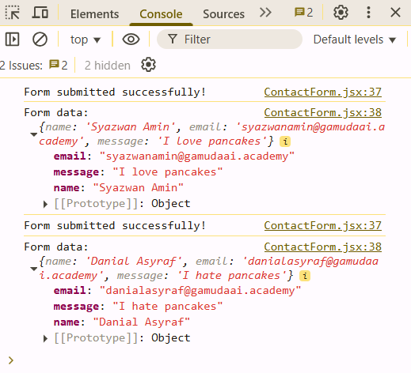
Example 3: Form Handling with Validation
1. State Management
Uses useState hook to manage form data.
Tracks name, email, message, and subscribe checkbox.
4. Form Features
Controlled components (React manages form state)
Form reset after successful submission
Submit button disabled until required fields are filled
Newsletter subscription checkbox option
2. Form Handling
handleInputChange: Updates form state when user types
handleSubmit: Processes form submission with validation
5. User Experience
Real-time validation feedback
Console logging for debugging
Clean form reset after submission
3. Validation
Checks for required fields (name, email, message).
Provides user feedback via alerts.
Visual feedback with red borders for empty required fields.
Notes:
import { useState } from 'react';
function ContactForm() {
const [formData, setFormData] = useState({
name: '',
email: '',
message: '',
subscribe: false
});
const [errors, setErrors] = useState({});
const [isSubmitting, setIsSubmitting] = useState(false);
const handleInputChange = (e) => {
const { name, value, type, checked } = e.target;
setFormData(prev => ({
...prev,
[name]: type === 'checkbox' ? checked : value
}));
// Clear error when user starts typing
if (errors[name]) {
setErrors(prev => ({
...prev,
[name]: ''
}));
}
};
const validateForm = () => {
const newErrors = {};
if (!formData.name.trim()) {
newErrors.name = 'Name is required';
}
if (!formData.email.trim()) {
newErrors.email = 'Email is required';
} else if (!/\S+@\S+\.\S+/.test(formData.email)) {
newErrors.email = 'Email is invalid';
}
if (!formData.message.trim()) {
newErrors.message = 'Message is required';
} else if (formData.message.length < 10) {
newErrors.message = 'Message must be at least 10 characters';
}
return newErrors;
};
const handleSubmit = async (e) => {
e.preventDefault();
const validationErrors = validateForm();
if (Object.keys(validationErrors).length > 0) {
setErrors(validationErrors);
return;
}
setIsSubmitting(true);
try {
// Simulate API call
await new Promise(resolve => setTimeout(resolve, 2000));
alert('Form submitted successfully!');
setFormData({ name: '', email: '', message: '', subscribe: false });
} catch (error) {
alert('Submission failed. Please try again.');
} finally {
setIsSubmitting(false);
}
};
return (
<form onSubmit={handleSubmit}>
<div>
<label>
Name:
<input
type="text"
name="name"
value={formData.name}
onChange={handleInputChange}
style={{ borderColor: errors.name ? 'red' : 'initial' }}
/>
</label>
{errors.name && <span style={{ color: 'red' }}>{errors.name}</span>}
</div>
<div>
<label>
Email:
<input
type="email"
name="email"
value={formData.email}
onChange={handleInputChange}
style={{ borderColor: errors.email ? 'red' : 'initial' }}
/>
</label>
{errors.email && <span style={{ color: 'red' }}>{errors.email}</span>}
</div>
<div>
<label>
Message:
<textarea
name="message"
value={formData.message}
onChange={handleInputChange}
rows="4"
style={{ borderColor: errors.message ? 'red' : 'initial' }}
/>
</label>
{errors.message && <span style={{ color: 'red' }}>{errors.message}</span>}
</div>
<div>
<label>
<input
type="checkbox"
name="subscribe"
checked={formData.subscribe}
onChange={handleInputChange}
/>
Subscribe to newsletter
</label>
</div>
<button type="submit" disabled={isSubmitting}>
{isSubmitting ? 'Submitting...' : 'Submit'}
</button>
</form>
);
}

Slide 13
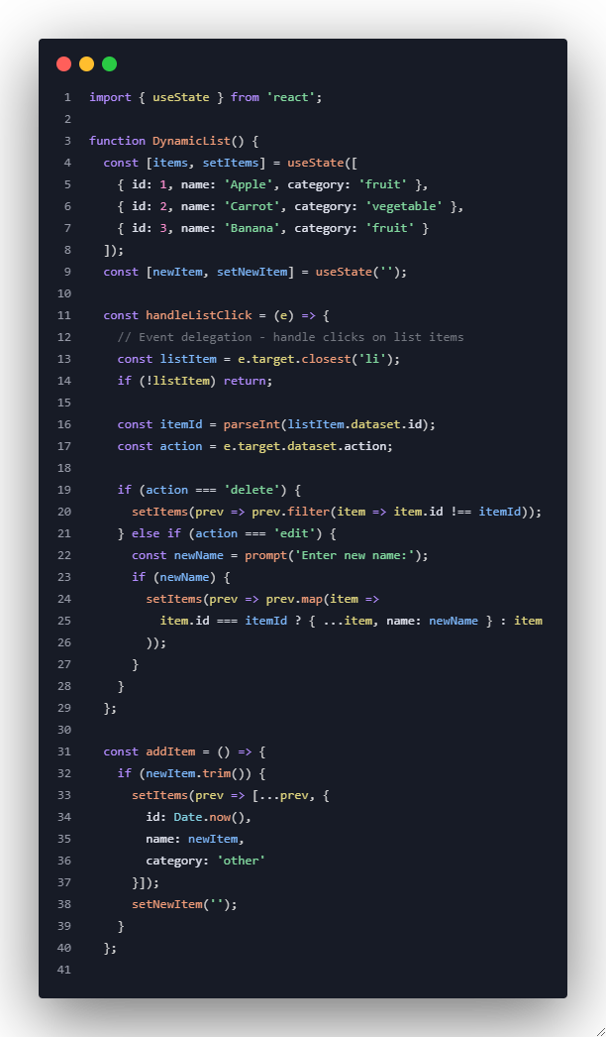
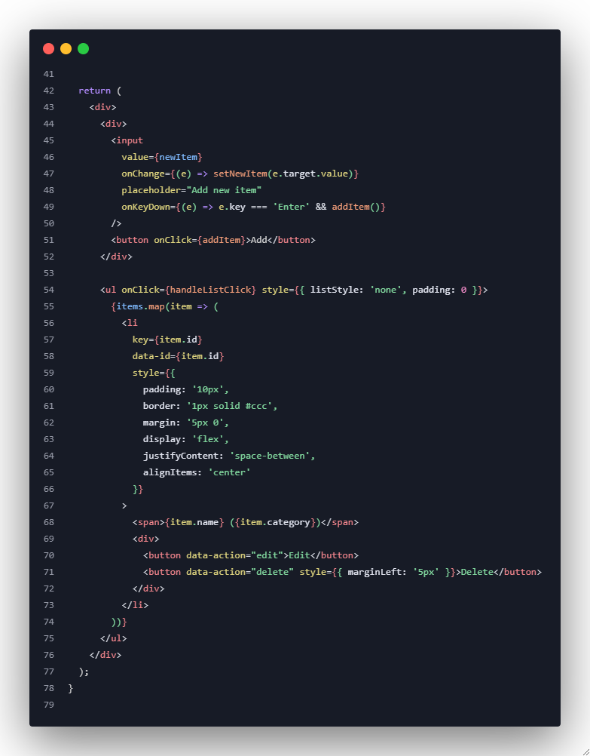
Example 4: Event Delegation and Dynamic Lists

Slide 14
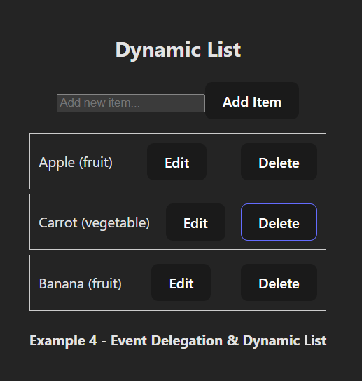
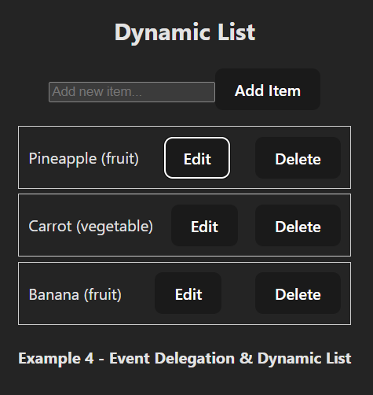
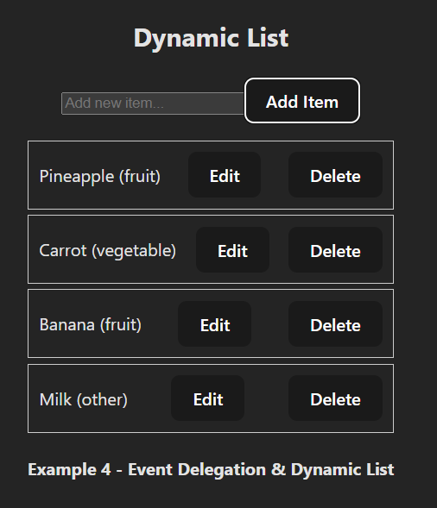
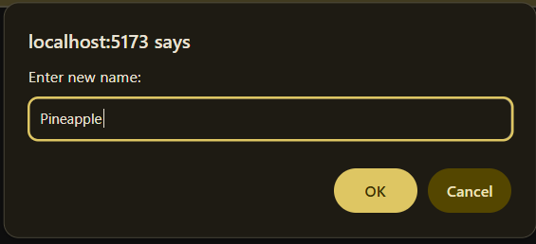
Example 4: Event Delegation and Dynamic Lists
Upon clicking edit => alert pops up => user can enter new name => new name displayed after click ok
Upon typing item name in form => click ‘Add Item’ button => new item displayed below existing items

Slide 15
Exercise 1: Image Gallery with Keyboard Navigation
Task: Build an image gallery that responds to keyboard events
Requirements:
Display array of images
Use arrow keys to navigate
Space bar to toggle fullscreen
Escape to close fullscreen
Click to select image

Slide 16
Exercise 2: Real-time Search Filter
Task: Create a searchable product list
Requirements:
Search input with real-time filtering
Category filter dropdown
Click to add items to favorites
Clear search on Escape key
Enter key to select first result

Slide 17
Mini-Project: Interactive Quiz Application
Task: Build a complete quiz application with rich interactions
Requirements:
Multiple choice questions with click selection
Keyboard navigation (1-4 keys for answers)
Timer with automatic submission
Progress bar that updates on each answer
Form validation before submission
Results screen with score and review
(Starter Structure is pasted in the presenter’s notes)
Notes:
function QuizApp() {
const [currentQuestion, setCurrentQuestion] = useState(0);
const [selectedAnswers, setSelectedAnswers] = useState({});
const [timeLeft, setTimeLeft] = useState(300); // 5 minutes
const [isSubmitted, setIsSubmitted] = useState(false);
const questions = [
{
id: 1,
question: "What is the capital of France?",
options: ["London", "Berlin", "Paris", "Madrid"],
correct: 2
},
{
id: 2,
question: "Which planet is known as the Red Planet?",
options: ["Venus", "Mars", "Jupiter", "Saturn"],
correct: 1
}
// Add more questions
];
// Students implement:
// - handleAnswerSelect
// - handleKeyDown for keyboard navigation
// - handleSubmit with validation
// - Timer functionality with useEffect
// - Results calculation and display
return (
<div>
{/* Quiz interface */}
</div>
);
}

Slide 18
Key Learning Outcomes
By the end of this session, students will be able to:
✅ Understand React's SyntheticEvent system
✅ Handle various types of user interactions (mouse, keyboard, form)
✅ Implement proper event handling patterns
✅ Build interactive and responsive user interfaces
✅ Use event delegation for dynamic content
✅ Implement form validation with real-time feedback
✅ Handle complex user interactions with multiple event types

